Slide 1

Course Name: Hardware Security
Faculty Name: Prof Debdeep Mukhopadhyay
Department : Computer Science and Engineering
Topic
Lecture 38: Power Analysis-XIV

Slide 2

Concepts Covered:
Template Attacks
Multivariate Normal Distribution and Noise
Correlation in Power Traces
Maximum Likelihood Decision Rule
Numerical Instability and Reduced Templates
Least Square Test (LSQ)

Slide 3
Template Attacks
Strongest form of side channel attacks
Require an adversary to have access to an identical experimental device that he can program to his choice.
The success of these attacks relies on the ability to model noise.
This helps to extract maximal knowledge from each sample.
Threatens countermeasures, which rely on the fact that many samples would not be available to the adversary
In template attacks the adversary needs few, and ideally a single trace!

Slide 4
Multivariate Normal Distribution and Noise
We have seen that the electronic noise at every point of a power trace is normally distributed.
However, this model does not take into account the correlation between neighboring points.
In order to do so, we model the power trace as a multivariate normal distribution.
This is a generalization of the normal distribution to higher dimensions.
It can be described by a covariance matrix C and a mean vector m.

Slide 5
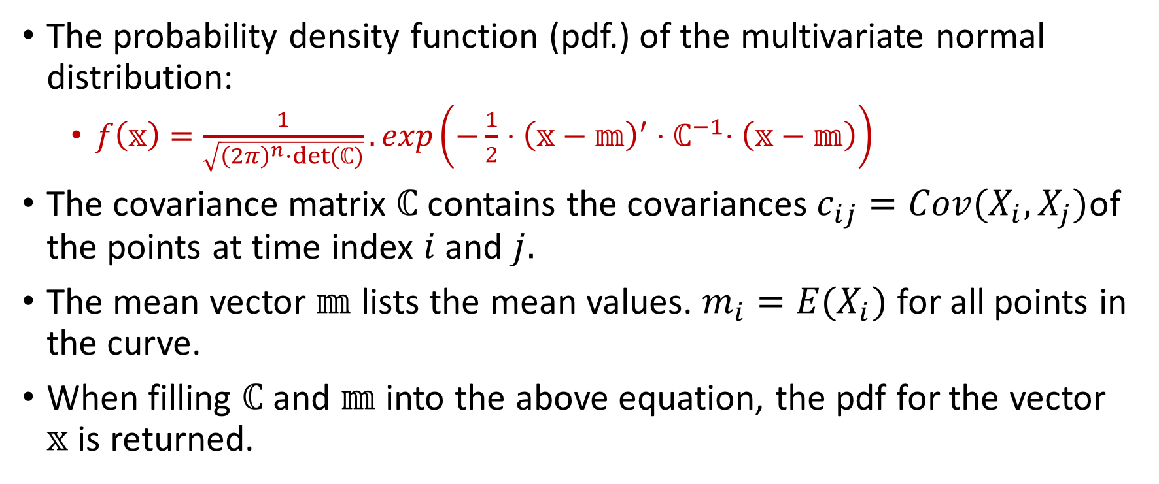
Definition of Multivariate Gaussian Model

Slide 6
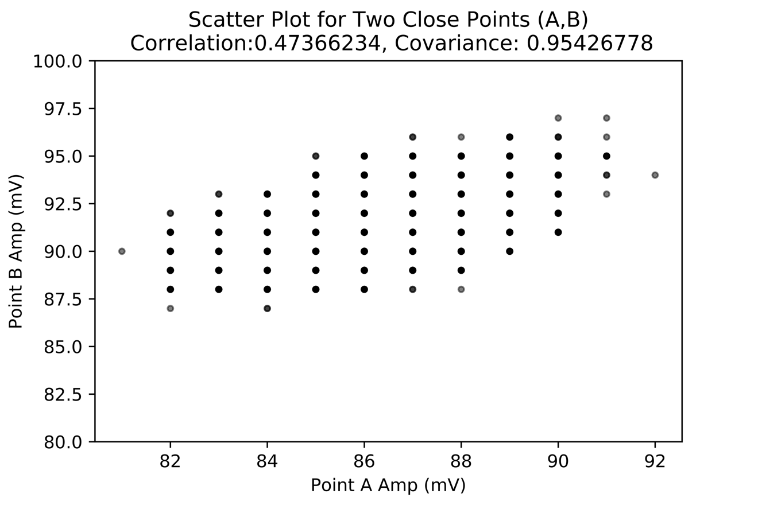
Correlation in Power Traces
Electrical noise usually does not change significantly from one point of the power trace to the next.
Hence, the electrical noise that is present in neighboring points is typically related.
Scatter plot helps to visualize this fact.

Slide 7
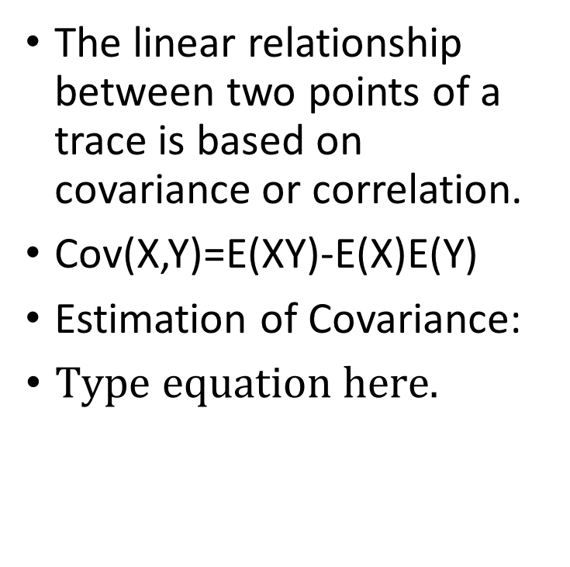
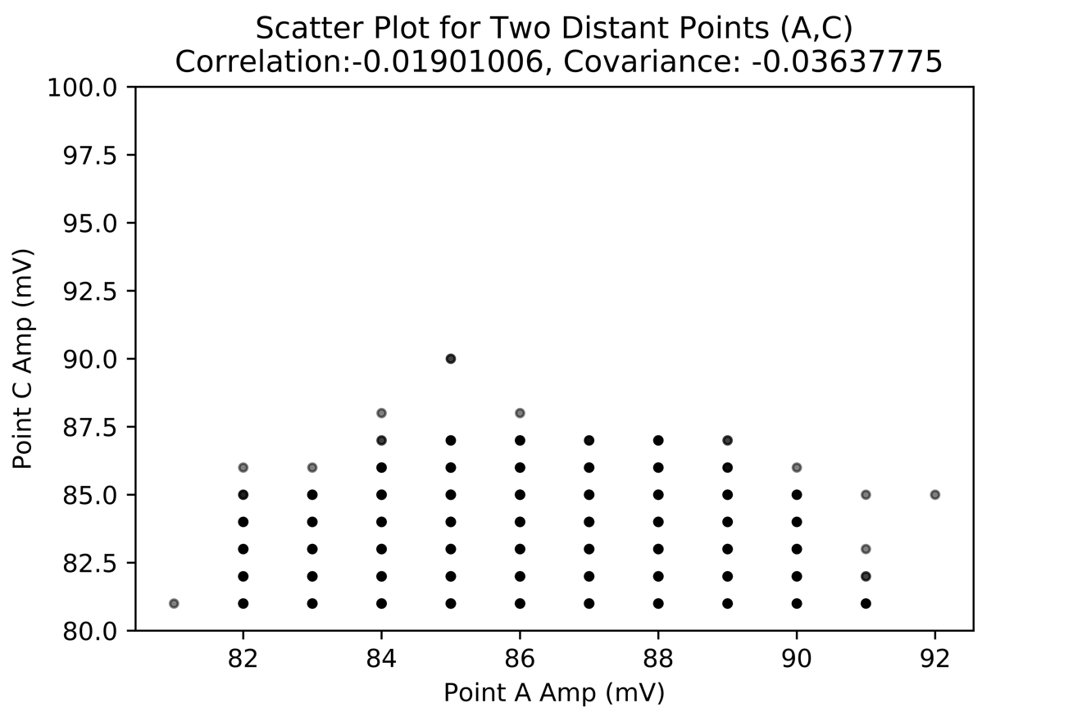
Correlation in Power Traces

Slide 8
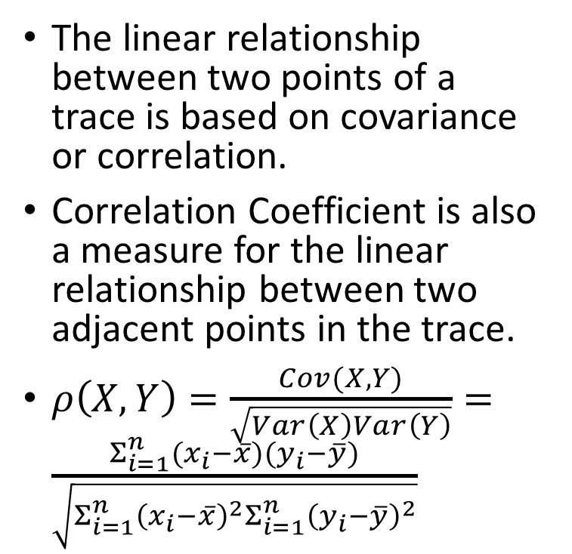
Correlation in Power Traces
The closer the points more is the correlation!

Slide 9
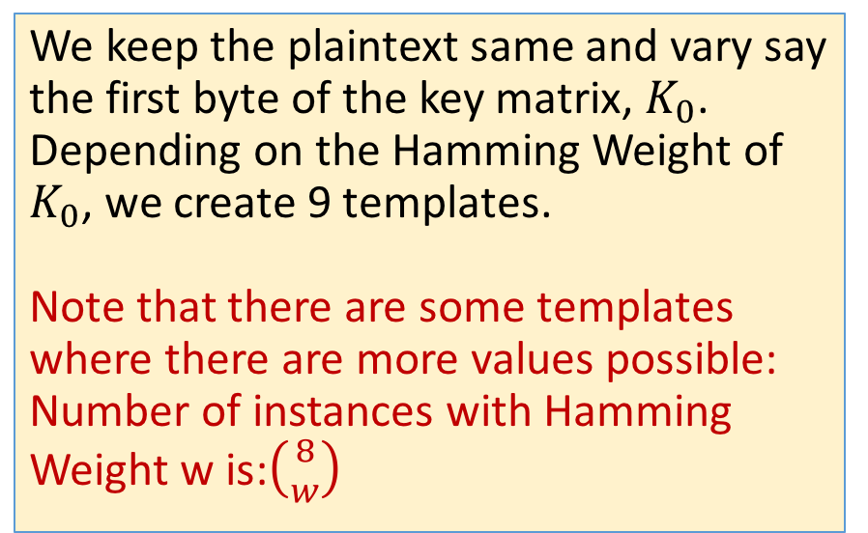
The AES Architecture and Template building Phase
Add Round Key
Keymem
Buffer
Byte Sub
Shift Row
Mix Column
Buffer
Add Round Key
Keymem
Buffer
Byte Sub
Shift Row
Add Round Key
Keymen
Buffer

Slide 10
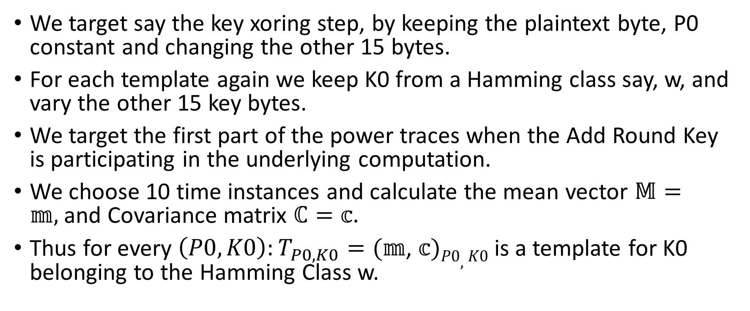
Creating Templates

Slide 11
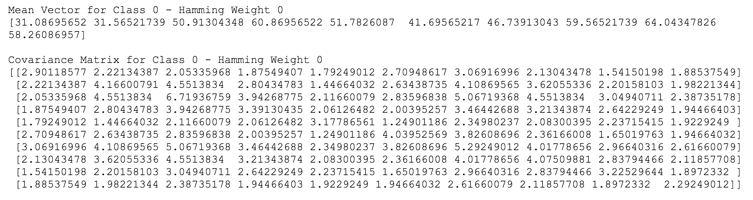
A Tale of Two Templates
Let us create two templates with Hamming Weight 0 and 4.

Slide 12
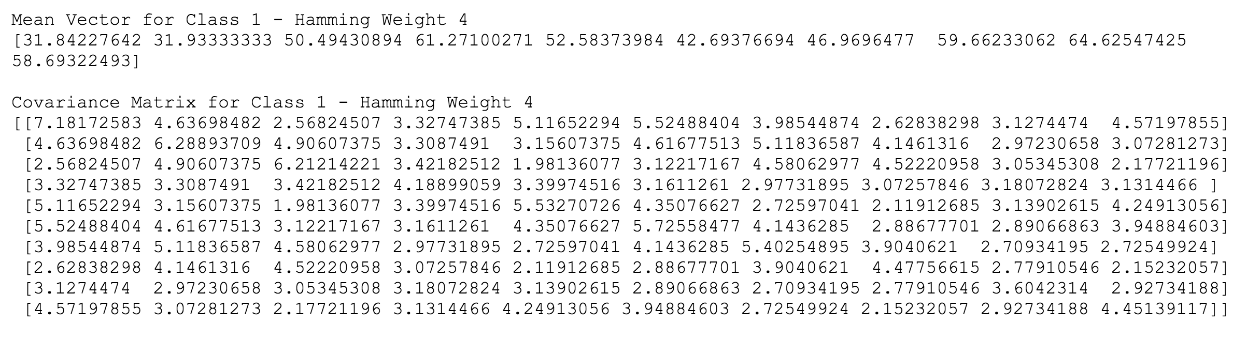
Template for Hamming Weight 4

Slide 13
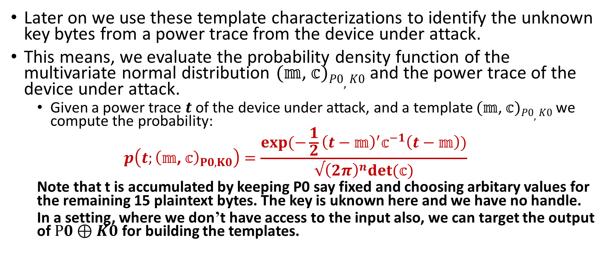
The Attack Phase

Slide 14
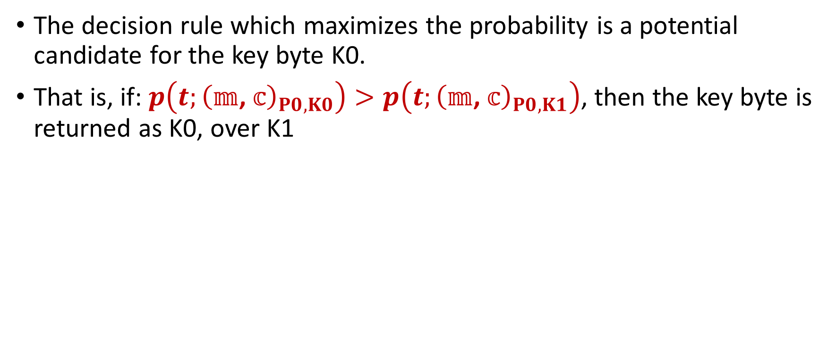
Maximum Likelihood Decision Rule

Slide 15
Case Study for Unknown Key
Unknown key has a K0 value of Hamming Weight 4
We compute the probabilities as mentioned wrt. the templates for 0 and 4.
Hamming Weight 0 Prob: 0.00000725
Hamming Weight 4 Prob: 0.00001790
This shows that it more likely that K0 has a Hamming Weight it 4, which is indeed correct!

Slide 16
For Another Few Runs
Trial 2:
Hamming Weight 0 Prob: 0.00000000
Hamming Weight 4 Prob: 0.00000336
Trial 3:
Hamming Weight 0 Prob: 0.00000000
Hamming Weight 4 Prob: 0.00000228
In all cases Hamming Weight 4 has a more likelihood from the template analysis

Slide 17
Numeric Problems in Template Analysis
While performing the template analysis, we can get into 2 important numeric problems:
These are related to the covariance matrix.
Size of the matrix depends on the number of important points, say n.
This must be chosen carefully.
There can also be problems arising out of the requirement of the existence of its inverse.
Also the exponent tends to be smaller and leading to inaccuracies.

Slide 18
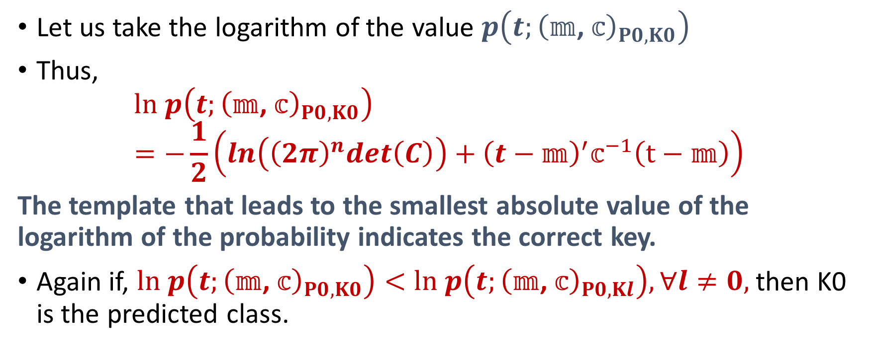
Numeric Manipulations

Slide 19
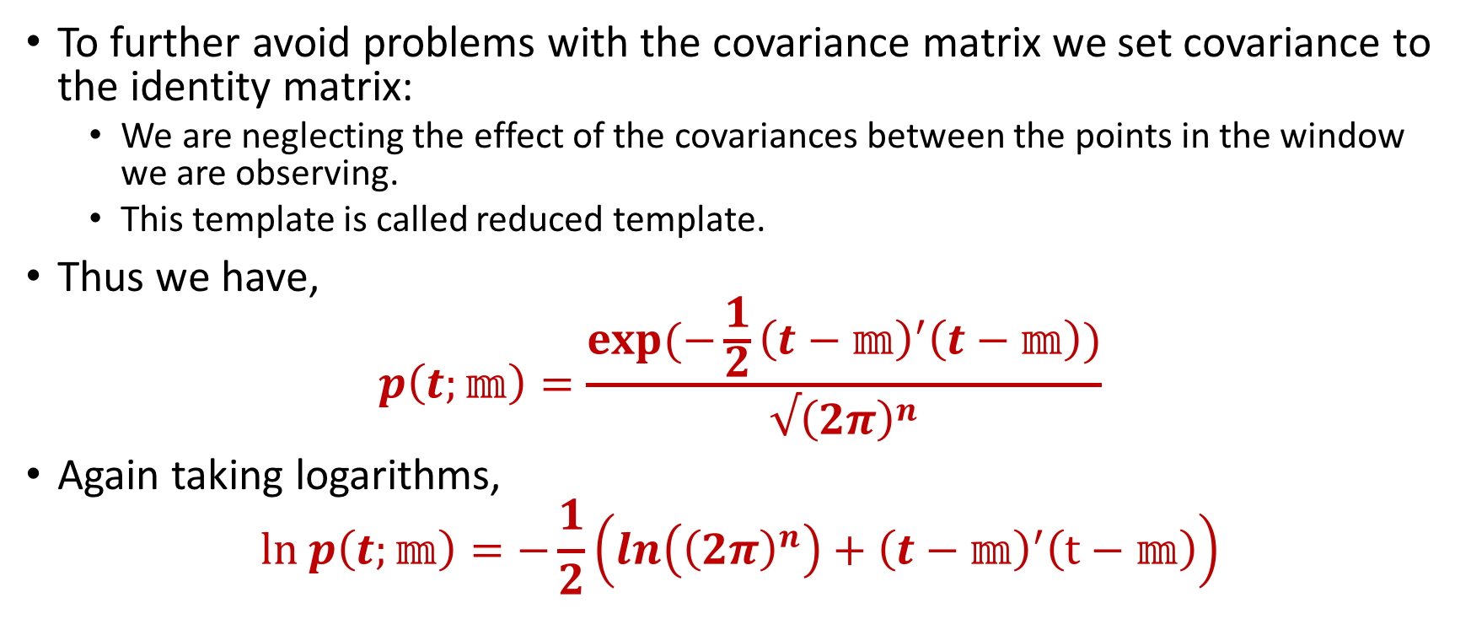
Reduced Templates

Slide 20
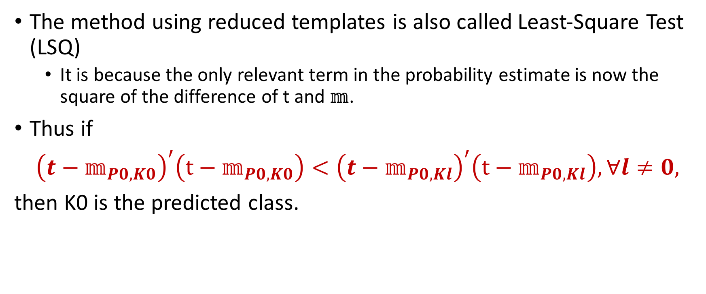
Least Square Test

Slide 21
LSQ in our Case Study
Trial 1:
Hamming Weight 0 Squared Difference: 19.07939509
Hamming Weight 4 Squared Difference: 32.18028070
Trial 2:
Hamming Weight 0 Squared Difference: 57.86200378
Hamming Weight 4 Squared Difference: 36.24640536
Trial 3:
Hamming Weight 0 Squared Difference: 94.03591682
Hamming Weight 4 Squared Difference: 66.37973869

Slide 22
Conclusions
Correlation across points in the trace leads to a multivariate normal distribution of noise.
Template attacks try to accurately model this noise.
Template matching is based on the maximum likelihood principle.
Reduced Templates help in performing template analysis with less numerical insgtability.
References:
1. Stefan Mangard, Elisabeth Oswald, Thomas Popp, Power Analysis Attacks: Revealing the Secrets of Smart Cards, Springer.
2. Suresh Chari, Joysula Rao and Pankaj Rohatgi, Template Attacks, CHES 2002.
3. Christian Rechberger, Elisabeth Oswald, Practical Template Attacks.

Slide 23


